Slide 1
Quantitative Biological Research with Python (92847)
TA 4 - Biopython and More Functional Programming

Slide 2
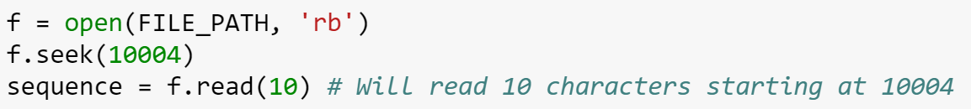
Handling big data
Huge files are common in biological databases
  Some are measured in terabytes (1TB = 1000GB)
Computers have a finite amount of memory
We don’t always have the luxury of loading the entire dataset to memory before processing it
One of the reasons why Python generators are so handy
  Biopython provides a generator interface
CPU-Memory tradeoff (e.g. hash tables)
Can also random-access files:

Slide 3
The FASTA format
A very simple and readable format for biological sequences (DNA, RNA and protein)
You can even write FASTA files by hand
FASTA stands for “FAST-All”, because it works with any alphabet
  [As opposed to "FAST-P" (protein) and "FAST-N" (nucleotide)]
  It’s a legacy from a 1985 sequence alignment software
Just a list of descriptors and sequences in one-letter code

Slide 4
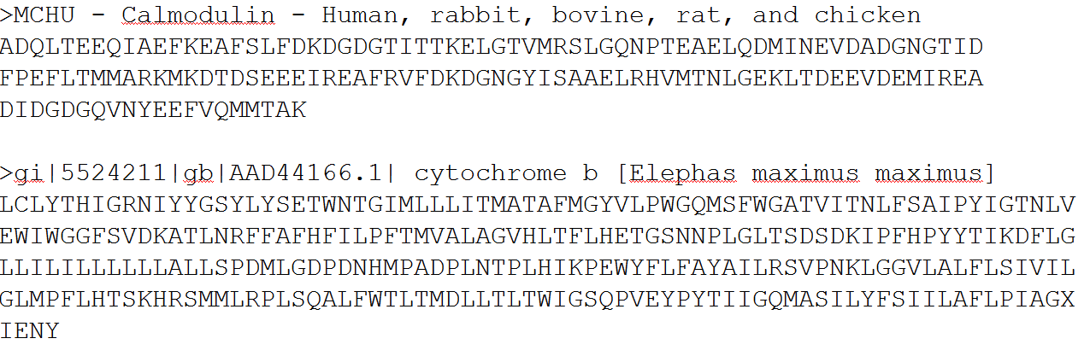
ID
Description
Sequence (white spaces are ignored)
…

Slide 5
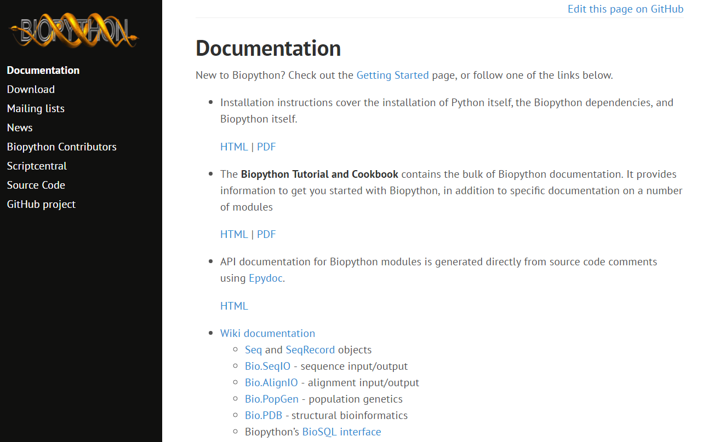

Biopython
SeqIO (reading & writing)
  FASTA
  GeneBank
Seq & SeqRecord objects
  Manipulating sequences
CodonTable, GC
Don’t forget citing the relevant papers if you use Biopython for your published work
http://biopython.org/wiki/Documentation

Slide 6
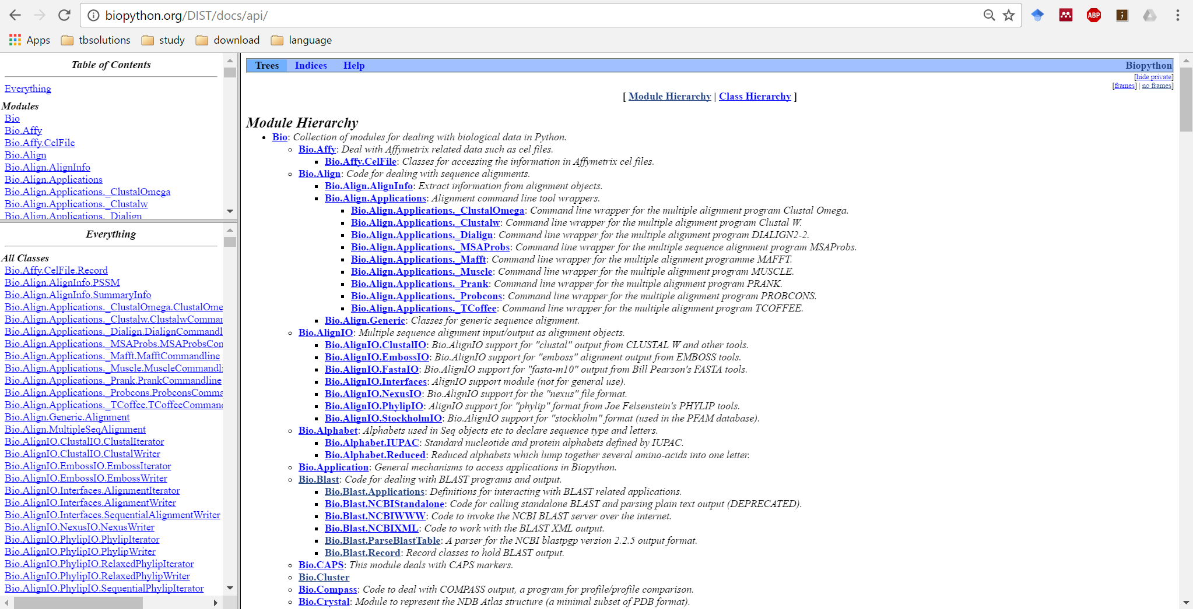

Slide 7
More Functional Programming
Recap
operator & itertools modules
One-liners
*args and **kwargs

